Slide 1
Team Name : Challenging Coders
Contest : IBM Hack Challenge 2020
Organised by Smartbridge
in collaboration with IBM
Team Intro
(June - July 2020)
Team Lead : Chowdam Venkata Thirumala Kumar(E2,ECE)
Team Members : Aaraveti Thirumalesh(E2,CSE)
Kanamarlapudi Sucharitha(E2,ECE)
Nallisiddi Sarika(E2,ECE)
College : Rajiv Gandhi University of Knowledge Technologies,RK Valley

Slide 2
Optimized Warehouse Management
With Auto AI

Slide 3
Problems Faced by the Food company in managing the warehouse
Wastage of raw materials
Out of stock
In both the cases the company faces economical loss

Slide 4
Reason for the problems:
Not able to estimate the correct requirement of raw materials.

Slide 5
Solution
Need a tool for estimating the requirement correctly.
Probably the estimation can be done by predicting the orders.
Machine Learning models are performing a great job in demand forecasting now a days.

Slide 6
Process of developing
Machine Learning Model
Data Collection
Data Pre-processing
Training
Testing
Deployment

Slide 7
Data Collection
For any demand forecasting projects we need to analyze the past data.
So we collected the data from Kaggle website.The data contains information regarding orders of 145 weeks.
Features in the data sets
Number of the Week
Center ID
Meal ID
Checkout Price
Base price
Emails used for promotion
Homepage featured
Number of orders

Slide 8
Data Pre-processing
Data needs to split into train and test sets.
Training data set is used to train the machine learning model and it contains 135 weeks data.
Testing data set is used to test the model manually and it contains 10 weeks data.

Slide 9
Training
To build our machine learning model we utilized services provided by IBM cloud.
To make our process simple we used Auto AI provided by the IBM cloud.
For utilizing those services we created an IBM cloud account.
Then we created all required services.

Slide 10
Training
Services required to use Auto AI (Model Building):
Cloud Object Storage Service(For storing the training data set)
Machine Learning Service(To provide machine learning backend for our Auto AI project)
Watson Studio Service
Service required to build UI:
Node-Red Service

Slide 11
Training & Testing
Trained the model by Auto AI by providing the training data set and saved the model.
Random Forest Regressor algorithm is used for training.
Tested with the test data after deploying.

Slide 12
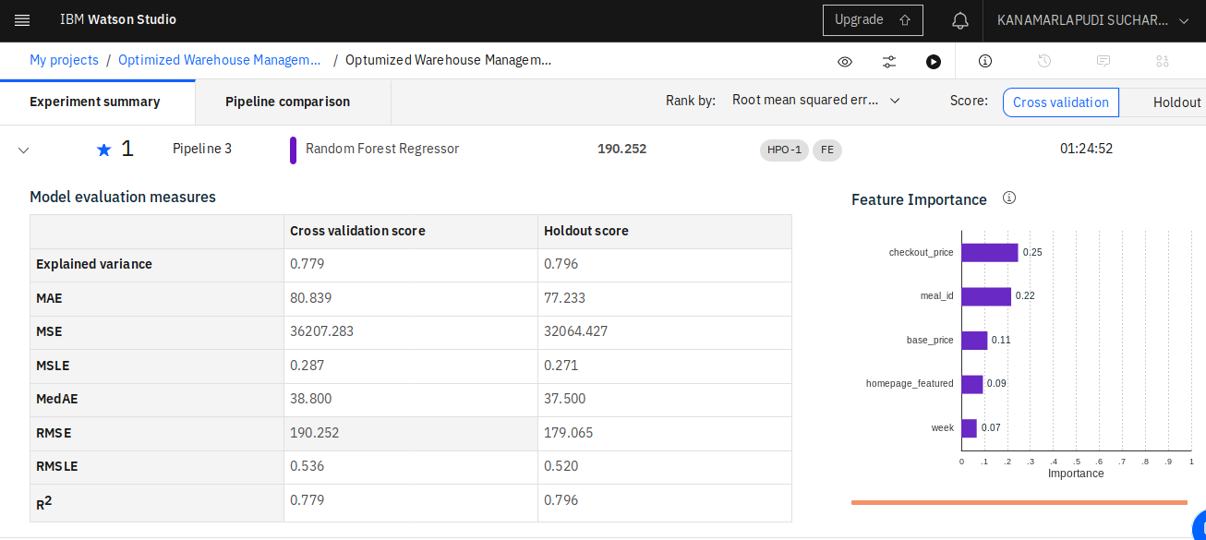
Training
Experiment Summary

Slide 13
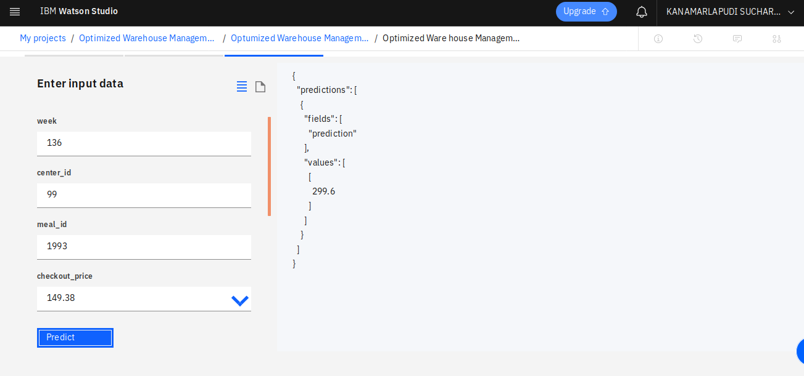
Testing

Slide 14
Deployment
UI is created by using Node-Red service in IBM Cloud.
Developed Machine Learning model is deployed on the UI.
Dynamic pie-chart and dynamic table is created on UI for better visualisation of the predictions.

Slide 15
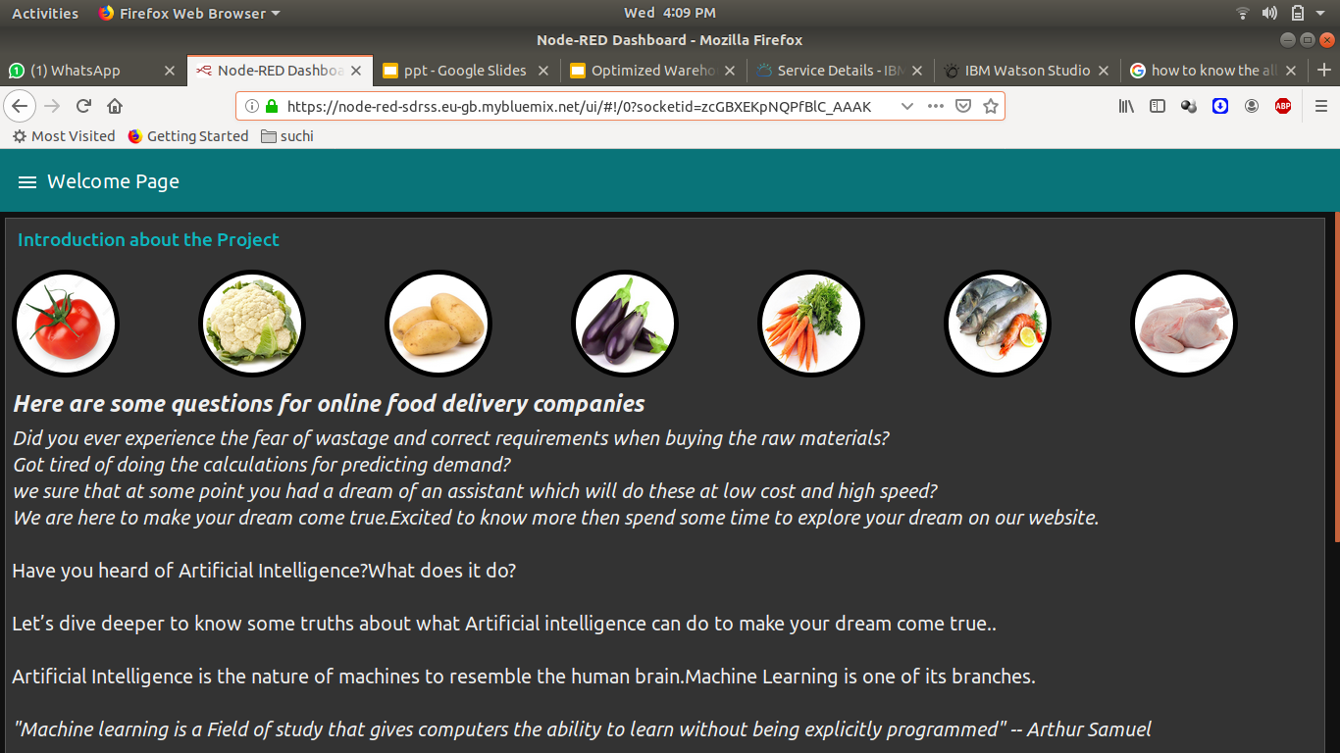
UI Link : https://node-red-sdrss.eu-gb.mybluemix.net/ui/

Slide 16
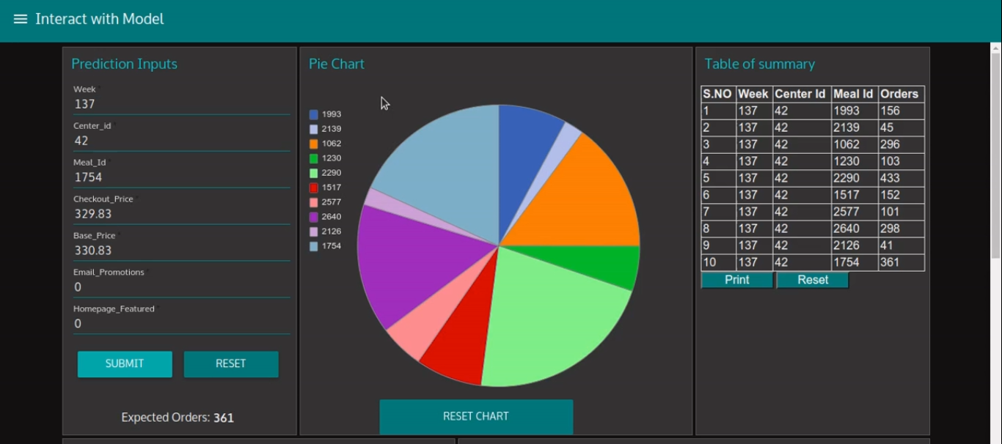
Interacting the model from UI

